Slide 1
Tails from the trenches:
How Caches fail at scale
Madelyn Olson
Valkey Maintainer and Engineer

Slide 2
Conventional in-memory scaling models
Vertical scaling – Add more CPUs to handle incoming requests
  Imbalanced unit economics (Mismatch of available hardware and requirements)
  Larger blast radius on individual failures and patching

Slide 3
Conventional in-memory scaling models
Horizontal scaling – Horizontally shard the data and route requests
  More components to maintain
  Limited ability to absorb burst capacity

Slide 4

Shard 1 (Slots 0 – 8196)
Shard 2 (Slots 8197 – 16343)
Primary
Primary
Replica
Replica

Slide 5
A story about a customer
Application
Primary
writes
Replica
reads

Slide 6
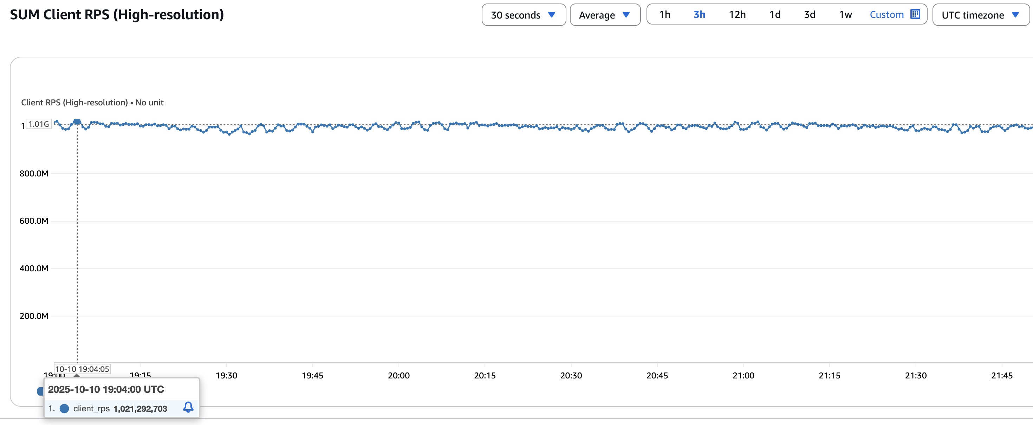
A story about a customer

Slide 7
Metastability

Slide 8
Stable system
Clients
req
req
req
req
retry
req
retry
req
retry²
req
retry²
req
retry²
req
retry²
req
Cache Layer
Cache UP
Backend Database

Slide 9
Unstable system
Clients
req
req
req
req
retry
retry
retry²
retry²
retry²
retry²
Cache Layer
✖ CACHE DOWN / COLD
Backend Database

Slide 10
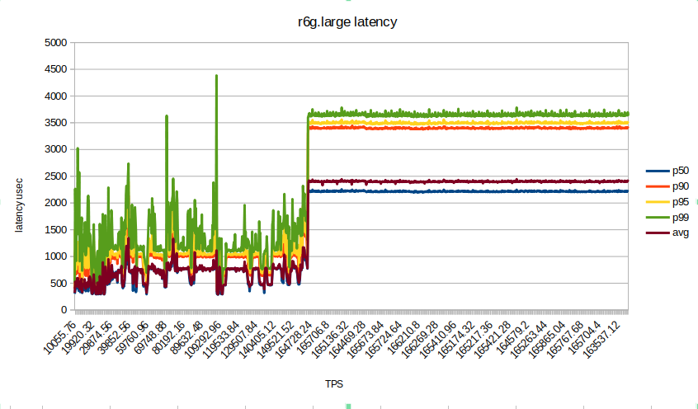
Throughput is a cliff

Slide 11
Bimodal systems

Slide 12
Different system modes of Valkey
State A
State B
Steady state
Replication
Static topology
Slot rebalancing
Full data
Empty cache

Slide 13
How did this system fail
Application
Primary
writes
Replica
reads

Slide 14
First in, never out
Application
Kafka Queue
Consumer
writes
read
Context
Cache
writes
read

Slide 15
First in, never out
Application
Kafka Queue
Consumer
writes
Context
Cache
writes

Slide 16
First in, never out
Application
Kafka Queue
Consumer
writes
read
Context
Cache
writes
read

Slide 17
To proxy, or not to proxy
Application
Proxy
Cache 1
Cache 2
Cache 3

Slide 18
To proxy, or not to proxy
Application
Proxy
Cache 1
req
req
Cache 2
Cache 3

Slide 19
Takeaways

Slide 20
Think about failure modes
What are your operating modes?
What triggers transitions from stable to unstable?
Can the system recover on its own?
What breaks the feedback loop?

Slide 21
Some best practices
Test network partitions, cache failures, and other system transitions
Make sure timeouts are handled and trigger the right behavior
Scale proactively when possible
Make sure to measure the right system bottlenecks

Slide 22
Madelyn Olson
@reconditerose
github.com/madolson

